Slide 1
Abdul, Ashik & Dipak
Final Year Project

Slide 2
Social Media Platform
Face Pedia

Slide 3
About me
I’m passionate about building great products that make people’s lives easier. Although I have just began my Web Development Journey, I am enjoying every aspect of this to my fullest.
For the sake of this Final Year Project I, Abdul Moin Raza have collaborated with Ashik Mirdda & Dipak Kr Yadav to build a great Social Media Website.

Slide 4
Skills & expertise
Motion design
User experience
Physical Computing
HTML, CSS,JS

Slide 5
A brief Introduction of Face Pedia

Slide 6

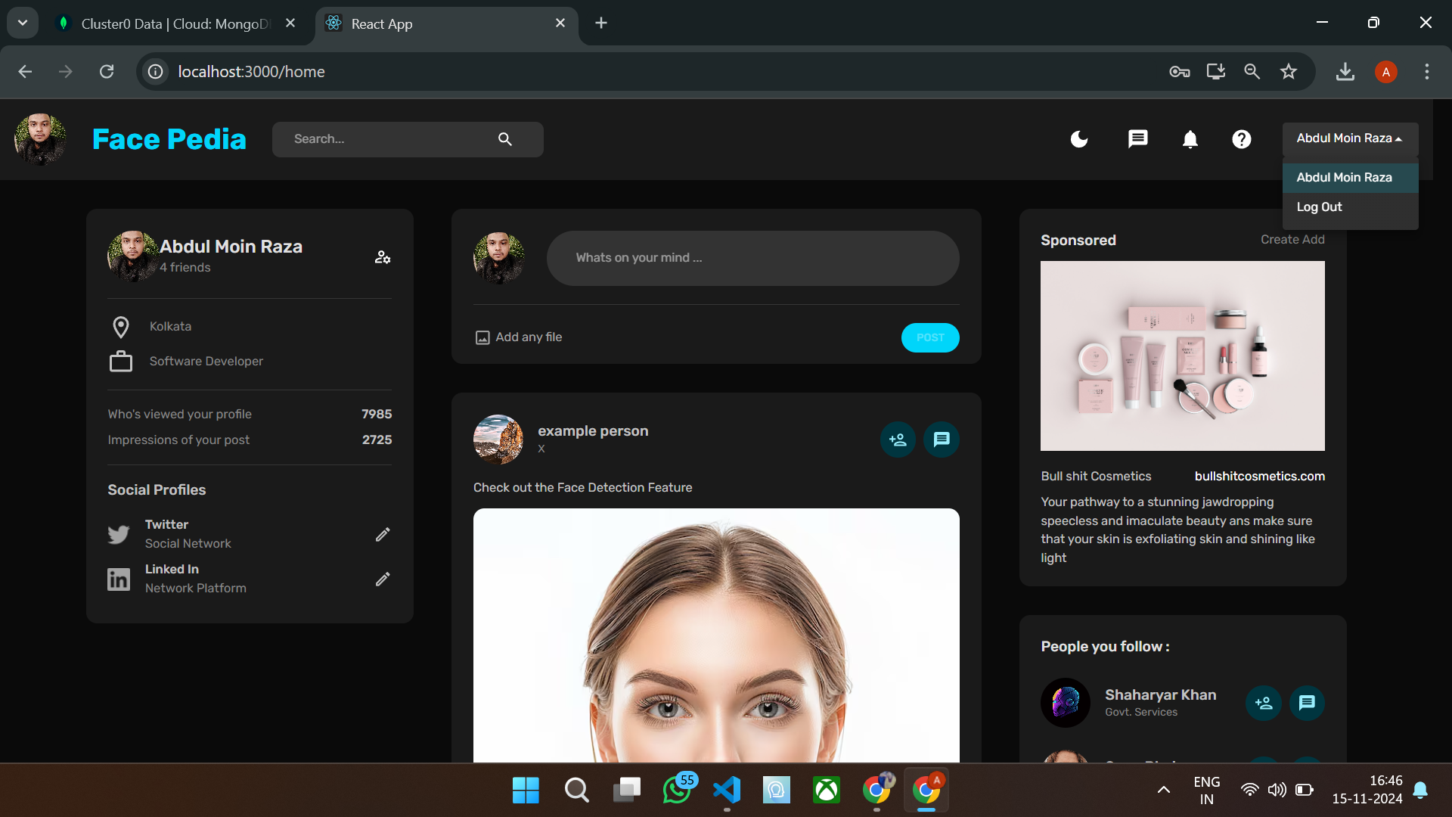

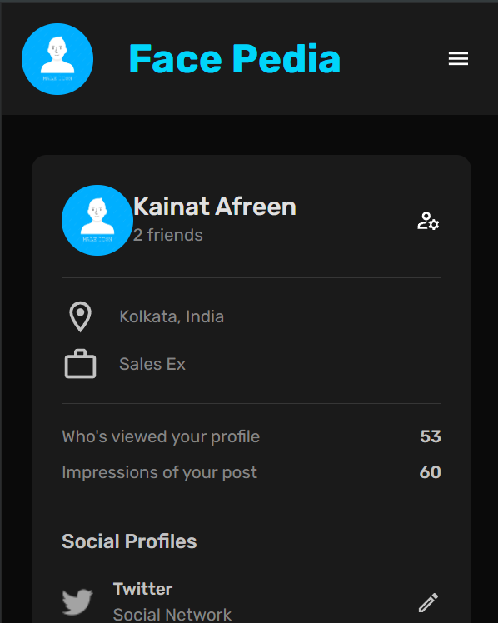
Face Pedia
Experience social media, redefined. Our minimalist approach, powered by React, Redux Toolkit, MongoDB, Express, and Node.js, offers a unique blend of simplicity and functionality.

Slide 7
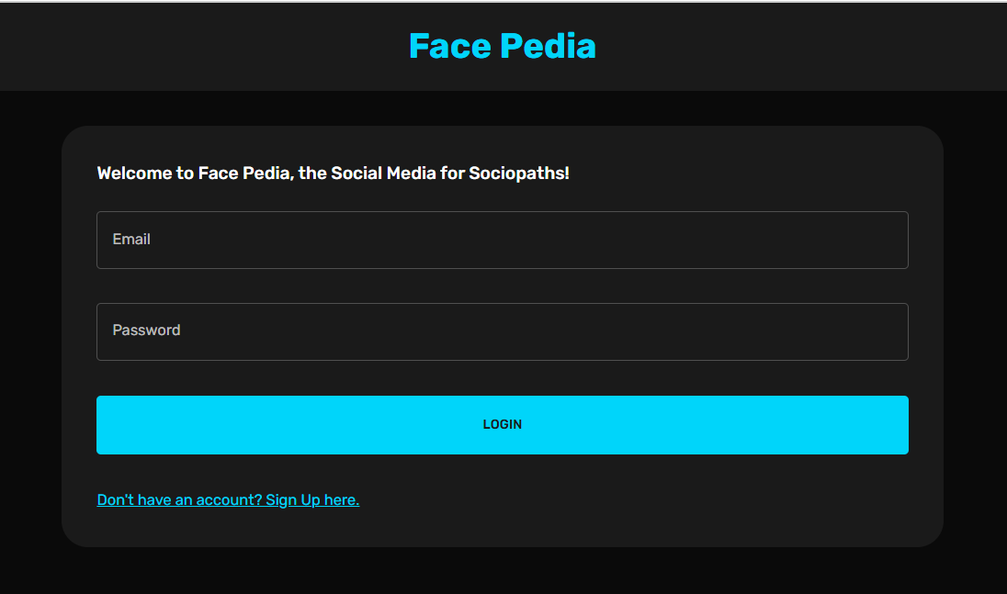
Login Page
Home Page
You can enter your Login details here, If you are already a user or else You can create an ID.
A simple Home Page where you can check out your profile The latest Posts and A list of People You follow.

Slide 8
Key highlights
Face Detection
If you upload a photo in a post which contains a face then upon hover over that post
Posts
You can upload posts images,videos or gifs.
Live Chat
Chat with anyone on the Web. People who are online can be seen in the messenger app.

Slide 9
Web Sockets
Socket.io has been used for live Chat Updates.

Slide 10
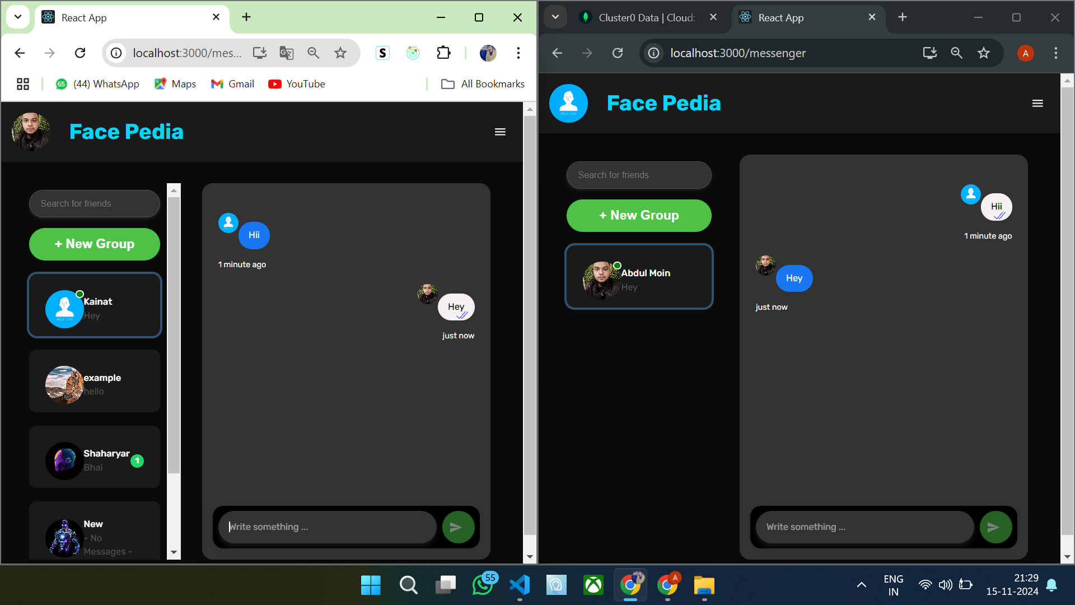

Slide 11
Face Detection on Mouse Hover

Slide 12
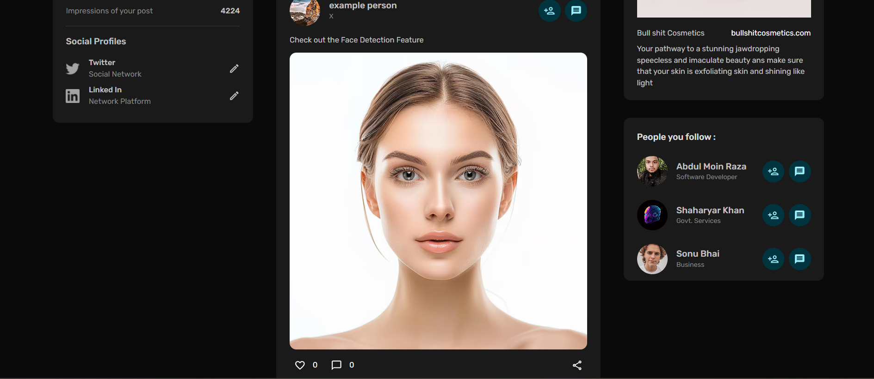
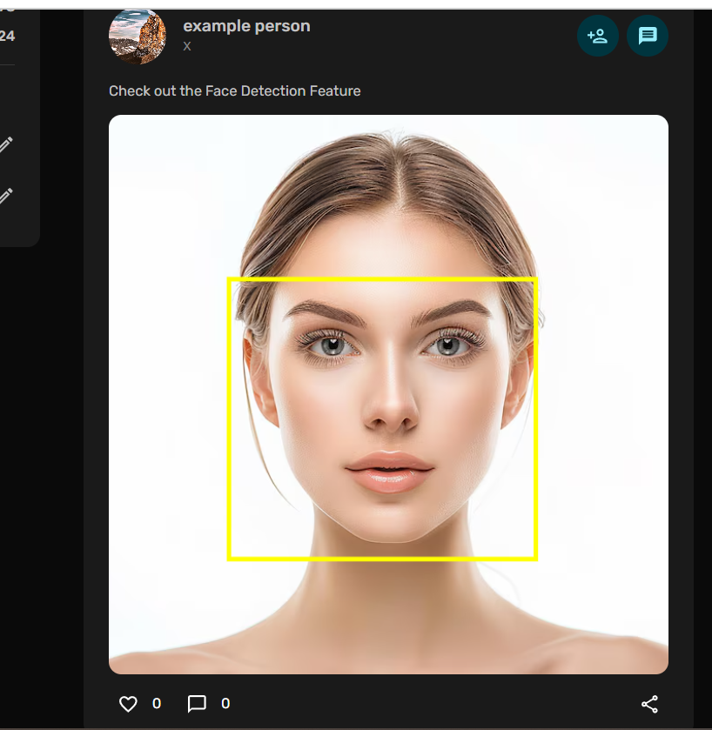

Slide 13
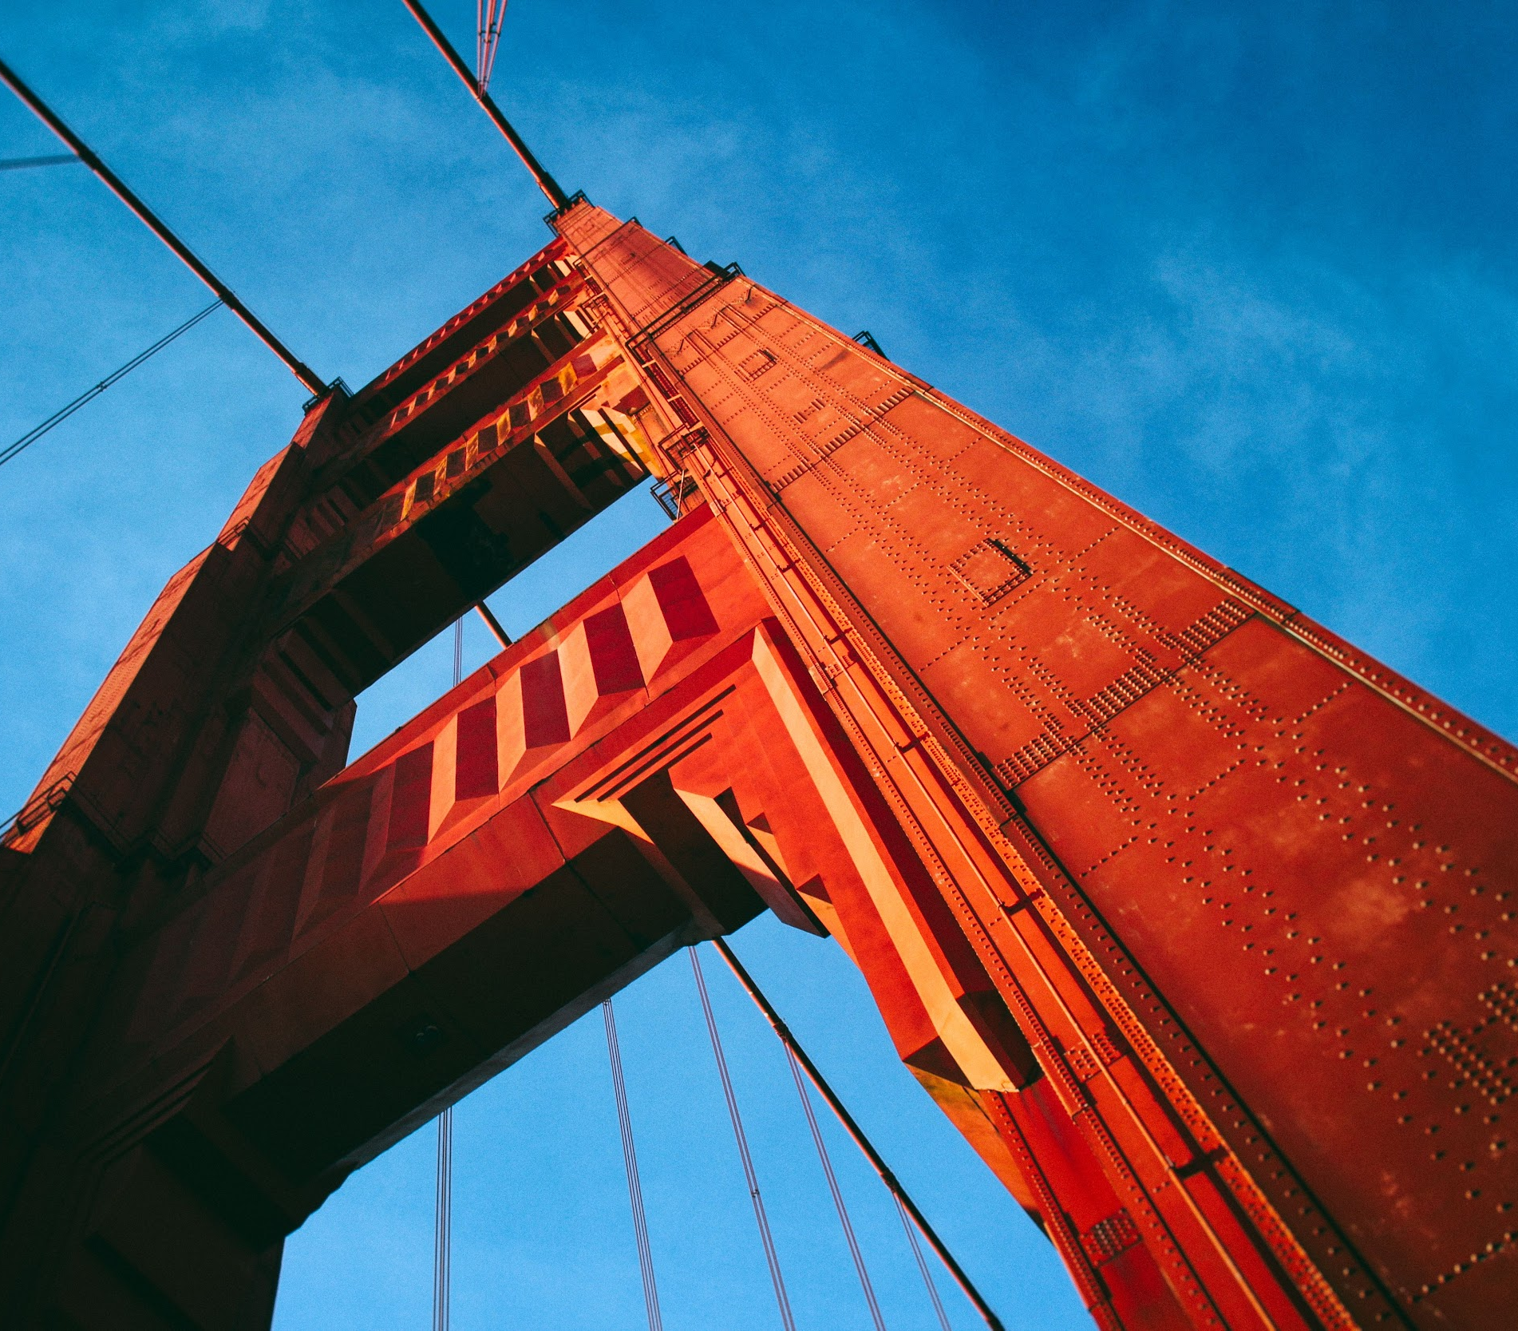
Contact
Abdul Moin Raza
Ashik Mirdda
Dipak Kr Yadav
M:8620881993
e:abdulmoinraza00100@gmail.com

